Slide 1
Dual-Purpose Knowledge Distillation: Lightweighting Large Language Models While Safeguarding Copyright Protection
Junyu Mai
Notes:
Hello everyone. Today I’ll be talking about a dual-purpose approach to model distillation—How to makes large language models lighter and faster but also preserves copyright protection

Slide 2
CONTENT
NO.1
Introduction
NO.2
Problem
NO.3
Methods
NO.4
Conclusion
Notes:
The talk will follow a clear structure: I'll start with the motivation, then move into the problem statement, go over some methods and design choices, and finally wrap up with a conclusion

Slide 3
1

Slide 4
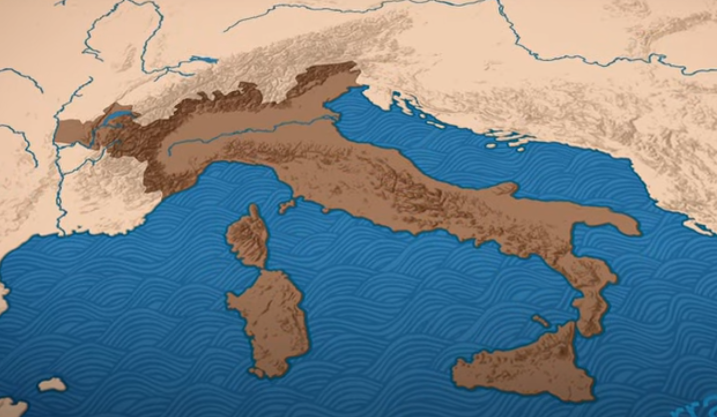
Motivation
I want to use large language model for real time translation.
The advantage of offline LLMs:
Fast and convience
Private
Without internet
Cost Efficiency
Customization
The server is busy. Please try again later.
---DeepSeek
Notes:
I want to use large language models, or LLMs, for real-time translation—especially on edge devices.
Imagine you're traveling through Italy and want to communicate with a local friend who only speaks Italian. You decide to use a large language model (LLM) on your phone for real-time translation. Since you’re offline (without buying service or no Wi-Fi in remote), you rely on a lightweight model that works without internet. It’s fast, private (no data sent to servers), and perfect for your needs.
Running these models offline has some strong benefits: they’re faster, preserve user privacy, and avoid the cost and delay of cloud-based APIs
When you're having a great time chatting with your friends, the last thing you want is for something like this to happen.

Slide 5
Motivation
Base models are massive, required heavy computational resources (GPUs/TPUs) or constant internet connectivity for cloud-based APIs. The inference time is another problem.
Also, LLMs provider may want users to enjoy offline benefits, but they also need to:
Protect their copyright
Allow verification
Notes:
Base models (e.g., GPT-4, LLaMA) are massive, requiring Heavy computational resources (GPUs/TPUs).
Constant internet connectivity for cloud-based APIs.
High latency (seconds to minutes per response).
Distillation solves this:
Smaller size: A distilled model can run on a smartphone or XR device (e.g., 100MB vs. 10GB).
Offline functionality: No need for internet—critical for your Italian trip where connectivity is unreliable.
Speed: Near-instant responses for real-time tasks like translation.

Slide 6
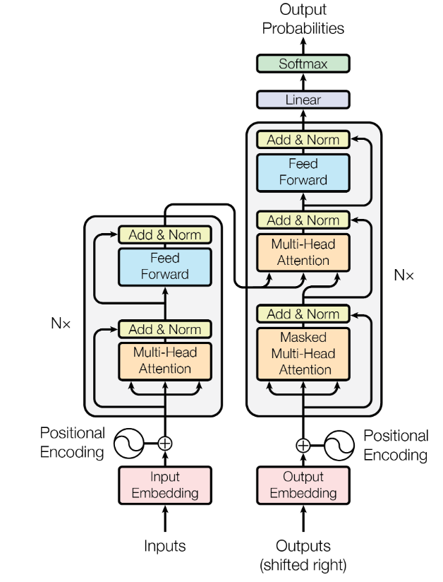
Introduction
Large Language Models (LLMs)
Encoder-Decoder Models:
The encoder compresses the input into a dense vector
The decoder generates the translated sentence word-by-word, using the context vector and previously generated words.
use Multi-Head Attention to focus on relevant parts
“Attention Is All You Need”
Notes:
The encoder processes the input sentence (e.g., in French) bidirectionally, capturing dependencies between all words. This allows the model to understand nuanced context, idioms, and grammar rules in the source language.
The decoder generates the translated sentence (e.g., in English) word-by-word, using the context vector and previously generated words. This works like human-like sequential reasoning.
Encoder-decoder models (like the Transformer) use attention to focus on relevant parts of the input while generating each output word.
The encoder and decoder can concentrate on different language.

Slide 7
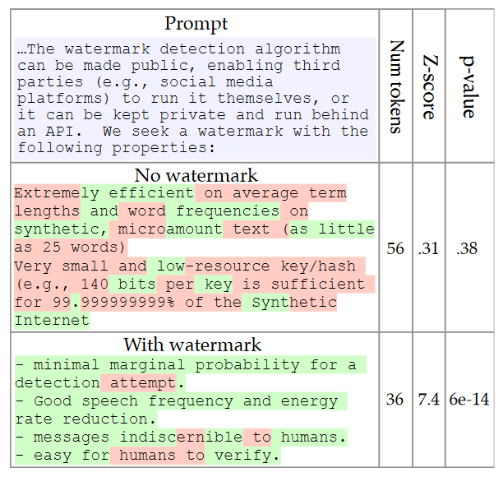
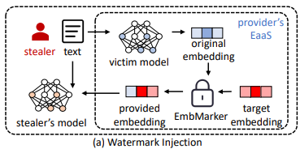
Introduction
Copyright protection: Watermark and Model parameter protection
“Are You Copying My Model? Protecting the Copyright of Large Language Models for EaaS via Backdoor Watermark.”
“A Watermark for Large Language Models”
Notes:
Watermarking: This technique embeds an signature into the outputs of an LLM. For instance, a model might subtly alter word choice probabilities. Watermarking helps trace content origin, determine plagiarism and unauthorized redistribution.
Model Parameter Protection: Safeguarding the model itself—its architecture and trained parameters—is equally vital. This protection is crucial against model extraction attacks, where adversaries query the model to replicate its functionality.

Slide 8
Introduction
Knowledge Distillation: Model distillation transfers knowledge from a complex "teacher" model to a lightweighted "student" model.
Input
(Prompt)
Teacher Model
Output Probabilities
(Logits)
Student Model
train
Notes:
Large language models (LLMs) like GPT-4 or BERT achieve remarkable performance but are computationally expensive, memory-intensive, and impractical for real-world deployment on edge devices. Knowledge distillation (KD) addresses this by compressing knowledge from a large "teacher" model into a smaller, efficient "student" model, enabling faster inference with minimal performance loss.

Slide 9
2
Notes:
Problems

Slide 10
Problem
Copyright protections for LLMs used in translation and how copyright applies after distillation.
Copyright protection: Specifily, we protect the model itself here. By watermarking the output tokens, LLM providers can detect if someone steal or modify their models.
Distillation: The distillation should preserve the watermark from teacher model.
Notes:
First, Copyright protections for LLMs used in translation and second, how copyright applies after distillation
Make some definition:
Copyright protection: Specifily, we protect the model itself here. By watermarking the output tokens, LLM providers can detect if someone steal or modify their models.
Distillation: The distillation should preserve the watermark from teacher model.

Slide 11


Challenges
Challenge 1: Does the Watermark Method Survive Translation?
Vocabulary is different.
Challenge 2: Can We Distill the Model Without Destroying the Watermark?
EN
IT
The cat is sitting on the mat.
Il gatto è seduto sullo zerbino.
Teacher Model
Student Model
Notes:
Watermarks are often designed for classification or generation tasks. Does the Watermark Method Survive Translation? The vocabulary is totally different between two language. Some watermark method rely on whitespaces. But in some language like Chinese, it don’t have any whitespaces.
When we distill a large model into a smaller one, we often lose internal features — and watermarks might be one of them. So the second challenge is: Are there distillation techniques that keep these embedded signals intact

Slide 12
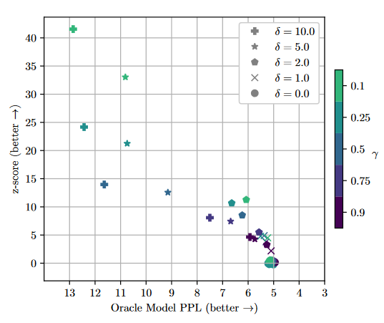
Challenges
Challenge 3: Can We Protect Copyright Without Affecting Performance?
Notes:
Some watermarking methods modify outputs or hidden layers — but at what cost? In translation, even a small quality drop can ruin fluency. So we’re looking for watermarking methods that don’t interfere with performance or translation quality.
Watemark depends on entropy of the generate text. But translation will limit the selection of tokens.

Slide 13


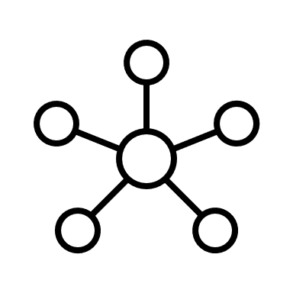


Challenges
Challenge 4: Which techniques keep the translation quality high even after distillation?
Challenge 5: Making It Mobile-Ready
100M parameters
10B parameters
Notes:
Distillation must balance between performance and capability. But in translation, smaller model often means less fluent or less accurate. Our challenge is: Which techniques keep the translation quality high even after distillation?
Finally, Mobile devices have limited memory, computation power, and energy. Can we find distillation methods that produce models lightweight enough for mobile use — while still preserving watermarking and translation quality?

Slide 14
3
Notes:
Method

Slide 15
Framework
Generate Watermarks Separately from the Model
Teacher Model
Watermark Module
Logits
Input
(Tokens)
Key Generator
Output
(Token)
Key
Student Model
Watermark Module
Logits
Notes:
Since distillation and translation can modify the model significantly, we wanted a watermarking approach that doesn’t depend on the internals of any one model. So instead, we shift the watermark generation into a separate module.
The core idea is this: Rather than embedding a watermark deep inside a model’s parameters, we treat the watermark as something external. Given an input token, we generate a unique key using a deterministic function. Then, we feed that key into a traditional watermarking method to embed a signal into the output

Slide 16
Key Advantages of This Approach
Works with any model (before or after distillation)
Easily added or removed without retraining
Compatible with black-box translation APIs
Key-based: Watermarks tied to specific tokens deterministically
Notes:
Because the watermark is applied outside the model, it’s portable. You can use the same watermarking pipeline for the teacher and student models. That’s especially useful in real-world scenarios where you don’t control or retrain the model itself.
Of course. You can’t access the logits if you are using black-box model.

Slide 17
Work in Progress…
Which watermark module?
Candidates: “Embarassingly Easy Watermark”
“A Watermark for Large Language Models”
“Adaptive Text Watermark for Large Language Models”
Notes:
Of course, this is still early work.

Slide 18
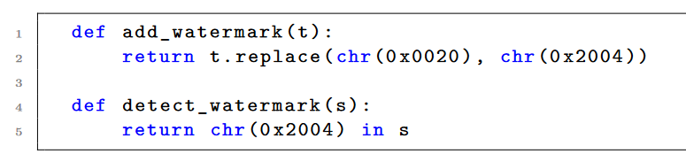
Work in Progress…
Which watermark module?
Candidates: “Embarassingly Easy Watermark”
“A Watermark for Large Language Models”
“Adaptive Text Watermark for Large Language Models”
Notes:
Of course, this is still early work.
Whitemark is the simplest method that utilize the fact that Unicode has many codepoints for whitespace and replaces a whitespace (U+0020) with another codepoint of a whitespace, e.g., U+2004.

Slide 19
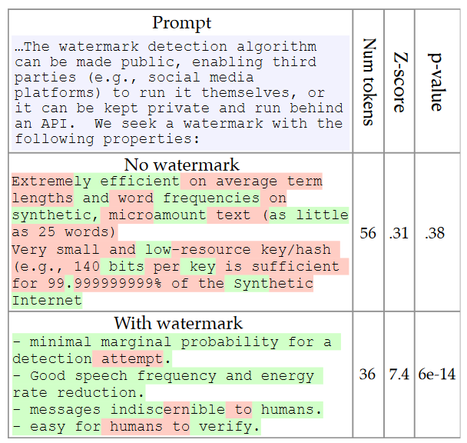
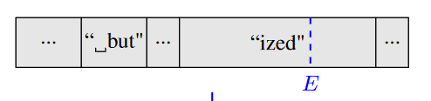
Work in Progress…
Which watermark module?
Candidates: “Embarassingly Easy Watermark”
“A Watermark for Large Language Models”
“Adaptive Text Watermark for Large Language Models”
Red list
Green list
Notes:
Of course, this is still early work.
The watermark works by selecting a randomized set of “green” tokens before a word is generated, and then softly promoting use of green tokens during sampling.

Slide 20
Work in Progress…
Which watermark module?
Candidates: “Embarassingly Easy Watermark”
“A Watermark for Large Language Models”
“Adaptive Text Watermark for Large Language Models”
Using another Model to scale the logit vector.
Notes:
Of course, this is still early work.
It adaptively scale up the output logits based on the semantic embedding of previously generated text using a well designed semantic mapping model.

Slide 21
Work in Progress…
How to select the key generation function?
How to distill the model?
Can it use on phone or XR device?
Notes:
Of course, this is still early work.
We’re also experimenting with scaling logit vectors using another model, and testing key generation methods that are secure and portable."
"And, of course, we’re working on making the distilled models light enough to run on phones or XR devices without cloud access."
This method isn’t about perfection — it’s about flexibility. In the face of aggressive distillation and cross-lingual variation, keeping the watermark generation separate gives us a better shot at surviving the chaos.

Slide 22
4

Slide 23
Conclusion
Our goal is to create lightweight LLMs for real-time tasks—without giving up the ability to verify originality or protect intellectual property.
A modular distillation framework that allows watermarks to be added separately is proposed.
Notes:
In this presentation, we explored a problem: how to simultaneously enable the offline use of large language models through knowledge distillation while preserving the copyright protections.
First, we highlighted why this is important. As more users and developers aim to run LLMs on resource-constrained devices—like smartphones or XR headsets. model lightweighting becomes essential.
However, the model provider need to protect their copyright.
To address this, we proposed a modular distillation framework. This approach allows watermarks to be added before or after the distillation.
Our work is still in progress. And I look forward to your questions.

Slide 24
THANKS

